Slide 1
2026.1.27
Group meeting

Slide 2
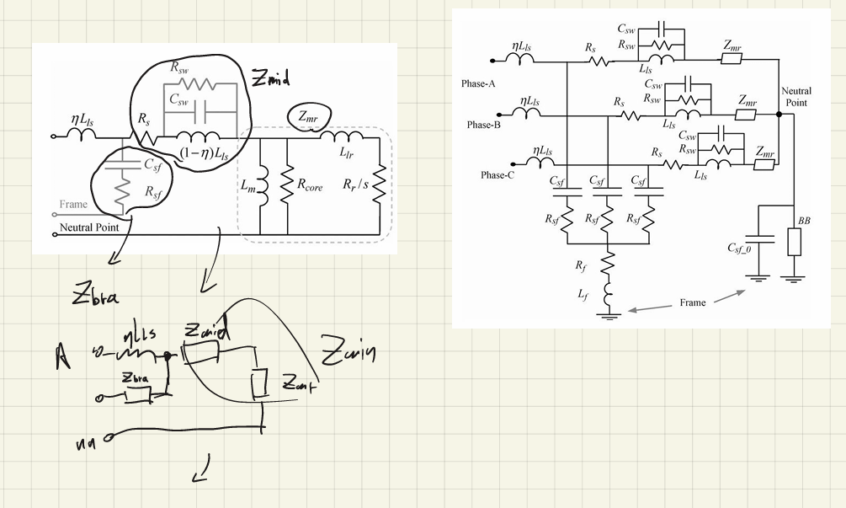
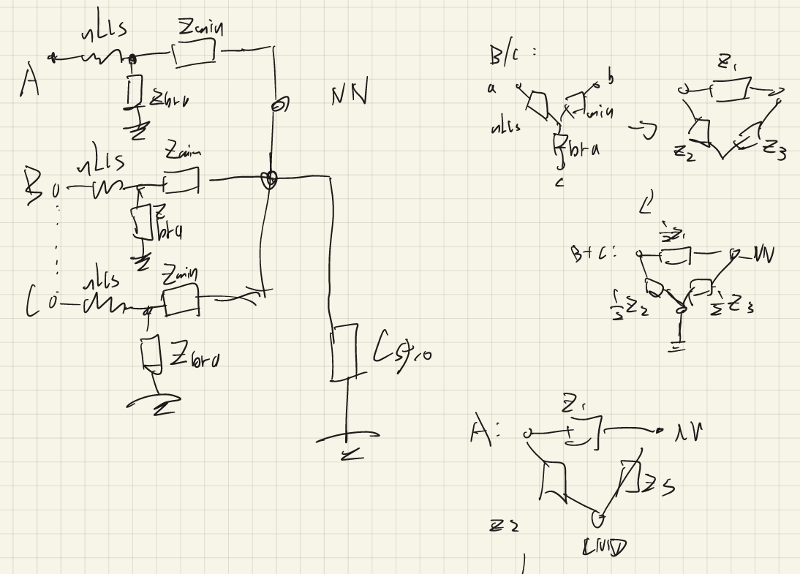
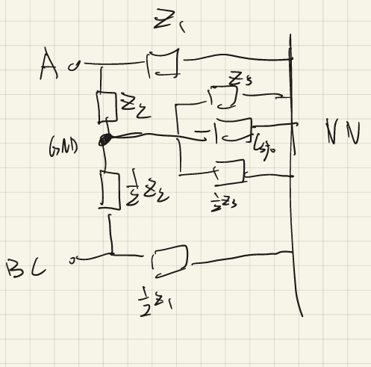
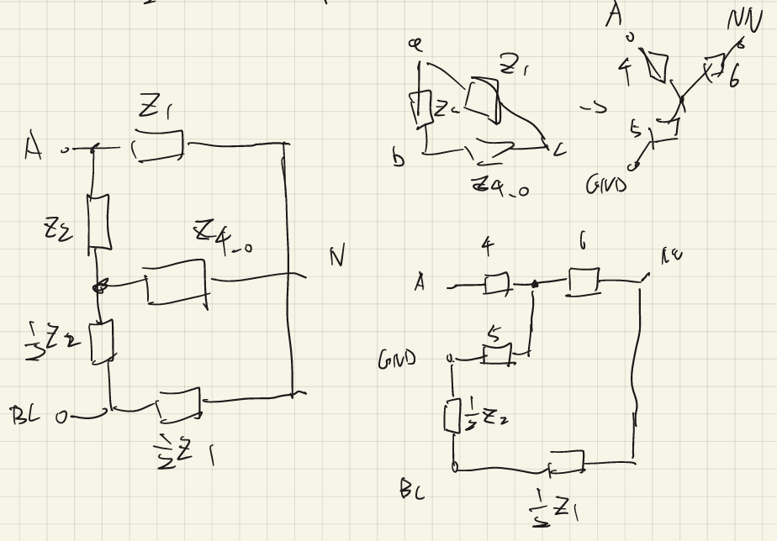
1
2
5
3
4
6

Slide 3
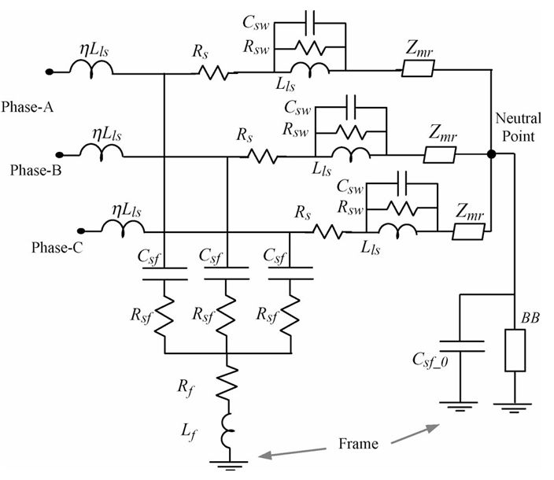
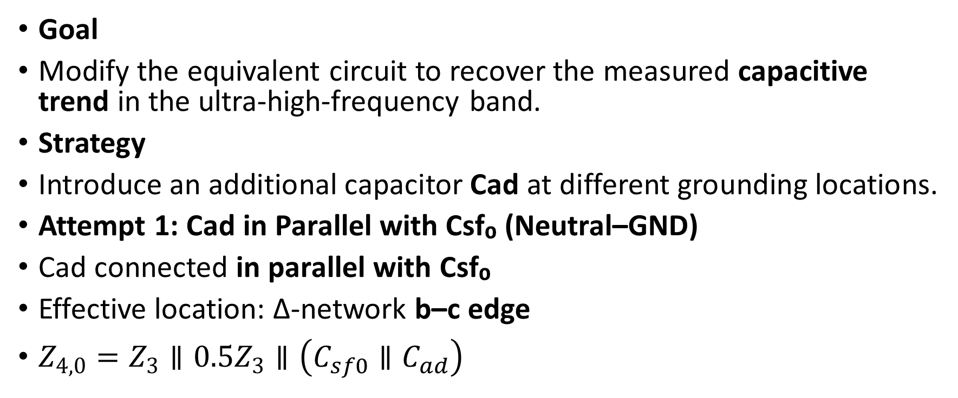
Attempts to Correct the 10⁷–10⁸ Hz Impedance Behavior
Goal
Modify the equivalent circuit to recover the measured capacitive trend in the ultra-high-frequency band.
Strategy
Introduce an additional capacitor Cad at different grounding locations.
Attempt 1: Cad in Parallel with Csf₀ (Neutral–GND)
Cad connected in parallel with Csf₀
Effective location: Δ-network b–c edge
$Z_{4,0}=Z_{3}∥0.5Z_{3}∥\left(C_{sf0}∥C_{ad}\right)$

Slide 4
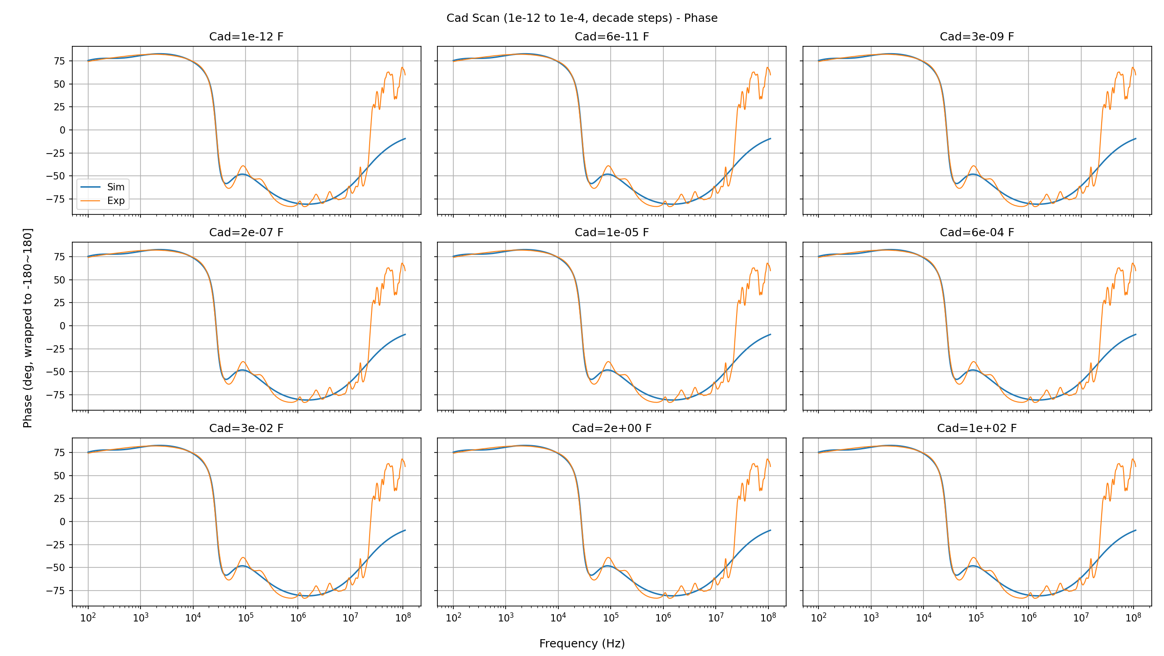
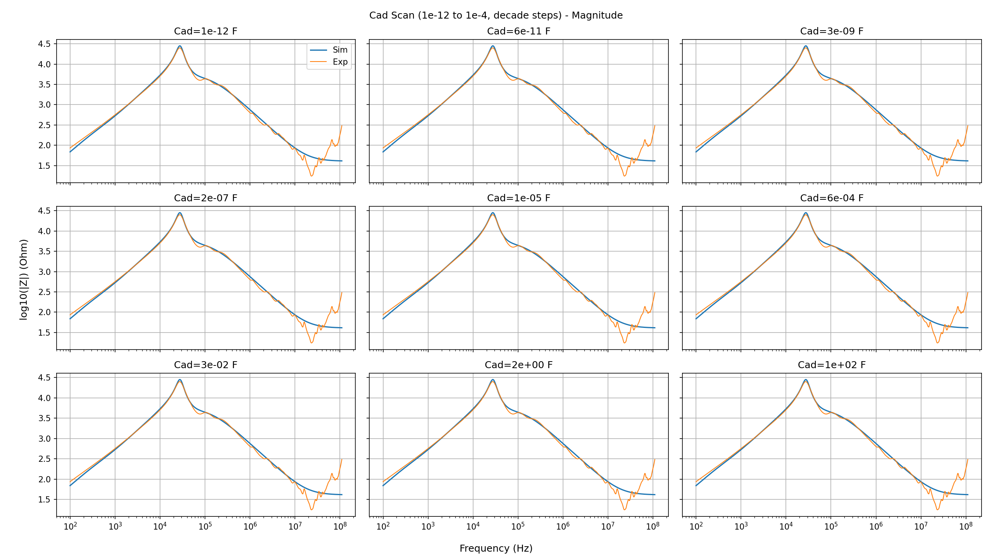
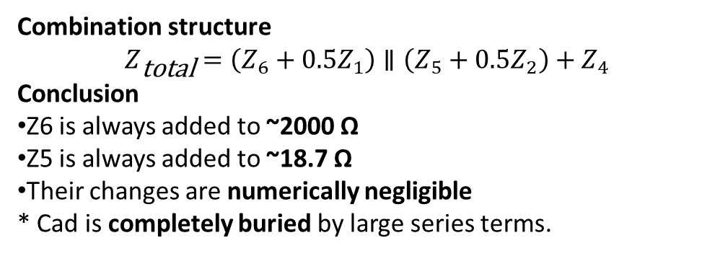
Attempt 1: Cad in Parallel with Csf₀ (Neutral–GND)
Cad | |Z4₀| | |Z6| | |Z5|
1e−12 F | 1.078 Ω | 1.071 Ω | 9.68e−3 Ω
1.78e−7 F | 4.30e−2 Ω | 4.27e−2 Ω | 3.86e−4 Ω
1e2 F | 7.96e−11 Ω | 7.91e−11 Ω | 7.14e−13 Ω
Observation
Z6 changes from ~1 Ω → ~1e−10 Ω
Z5 changes from ~1e−2 Ω → ~1e−12 Ω
→ Huge local variation
Term | Magnitude
|Z1| | 4.14 kΩ → 0.5·Z1 ≈ 2069 Ω
|Z2| | 37.38 Ω → 0.5·Z2 ≈ 18.7 Ω
Combination structure
$$Z_{\text{total}}=\left(Z_{6}+0.5Z_{1}\right)∥\left(Z_{5}+0.5Z_{2}\right)+Z_{4}$$
Conclusion
Z6 is always added to ~2000 Ω
Z5 is always added to ~18.7 Ω
Their changes are numerically negligible
* Cad is completely buried by large series terms.

Slide 5
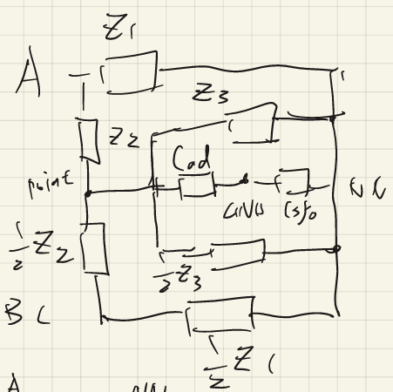

Attempt 2: Cad between Phases and Frame (A,B,C → GND)
Topology
Cad connected in series with Csf₀
Location: common stator–frame path
Cad | |Z4₀| | |Z6| | |Z5|
1e−12 F | 7.96 kΩ | 3.66 kΩ | 33 Ω
3.16e−9 F | 3.59 Ω | 3.57 Ω | 0.032 Ω
1e2 F | 1.08 Ω | 1.07 Ω | 0.0097 Ω
Observation
Z6: kΩ → 1 Ω
Z5: 33 Ω → 0.01 Ω
→ Cad is now fully effective locally
Term | Magnitude
|Z1| | 4.14 kΩ → 0.5·Z1 ≈ 2.07 kΩ
|Z2| | 37.38 Ω → 0.5·Z2 ≈ 18.7 Ω
|Z4| | ≈ 37 Ω
Dominance
Left branch always kΩ
Right branch always ≈ 18.7 Ω
Z4 ≈ 37 Ω (stable)
Structure
$$Z_{\text{total}}=\left(Z_{6}+0.5Z_{1}\right)∥\left(Z_{5}+0.5Z_{2}\right)+Z_{4}$$

Slide 6
Structural Limitation: Why Cad / Lad Cannot Fix UHF Behavior
Key Conclusion
Even when the added element (Cad or Lad) causes orders-of-magnitude changes in the local branches (Z6 and Z5), the total impedance remains almost unchanged.
This is because their influence is numerically buried by three dominant terms: 0.5·Z1 ≈ 2.07 kΩ, 0.5·Z2 ≈ 18.7 Ω, Z4 ≈ 37 Ω
These three terms lock the global impedance in the tens-of-ohms range, preventing any effective inductive–capacitive transition at 10⁷–10⁸ Hz.
Structural Interpretation
The current topology is structurally stiff: Z6 is always added to a kΩ-level term (0.5·Z1); Z5 is always added to a tens-of-ohms term (0.5·Z2)
The series arm Z4 is itself a stable, dominant branch
Therefore, even dramatic changes in Z6 or Z5 cannot compete numerically.
Additional Observation
Replacing Cad with Lad leads to the same outcome: Z6 and Z5 still vary strongly, but their effects are again completely masked by 0.5·Z1, 0.5·Z2, and Z4.

Slide 7
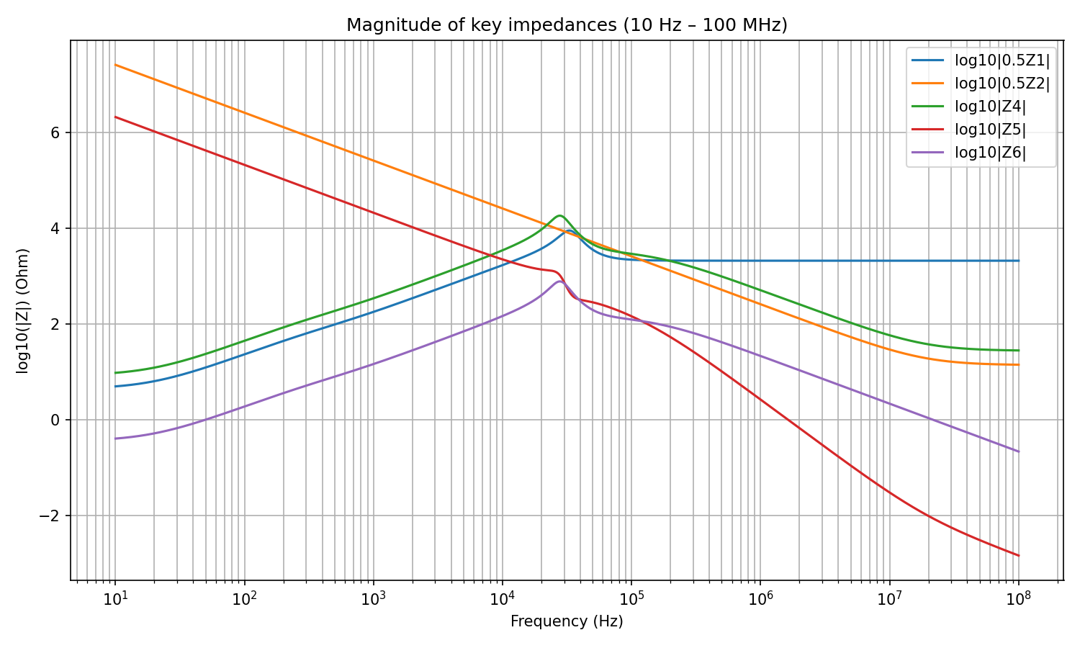
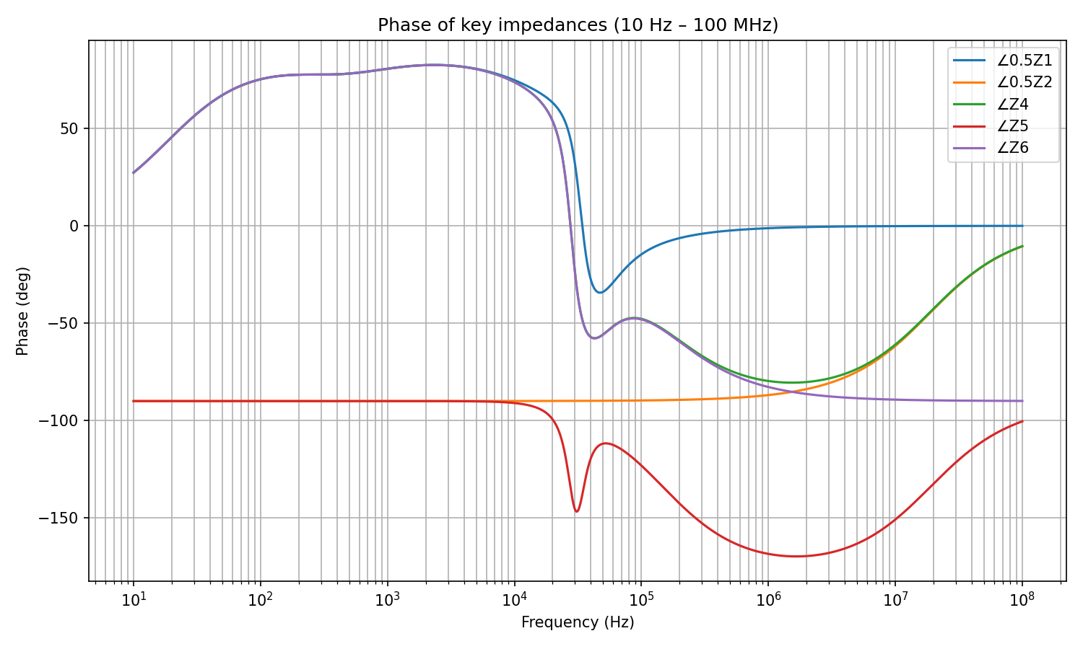
Analysis of the variation trend of each component of impedance

Slide 8
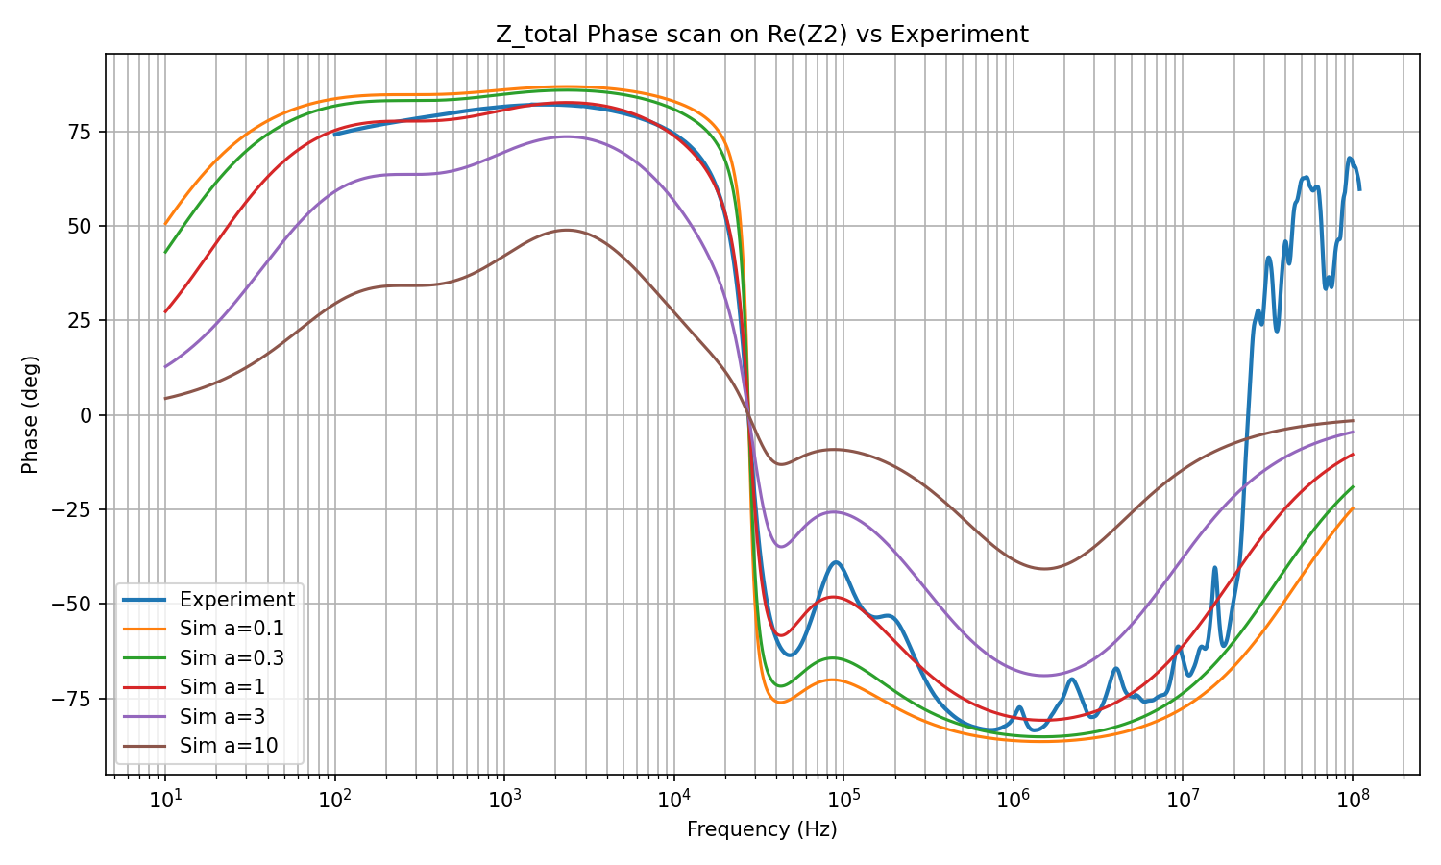
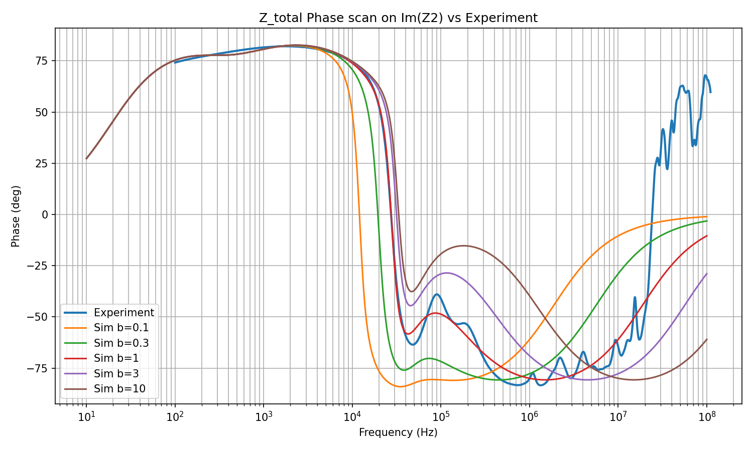
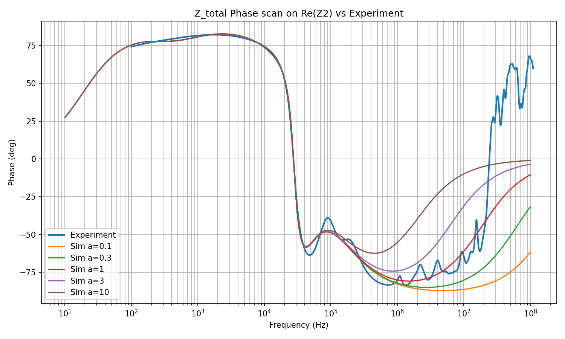
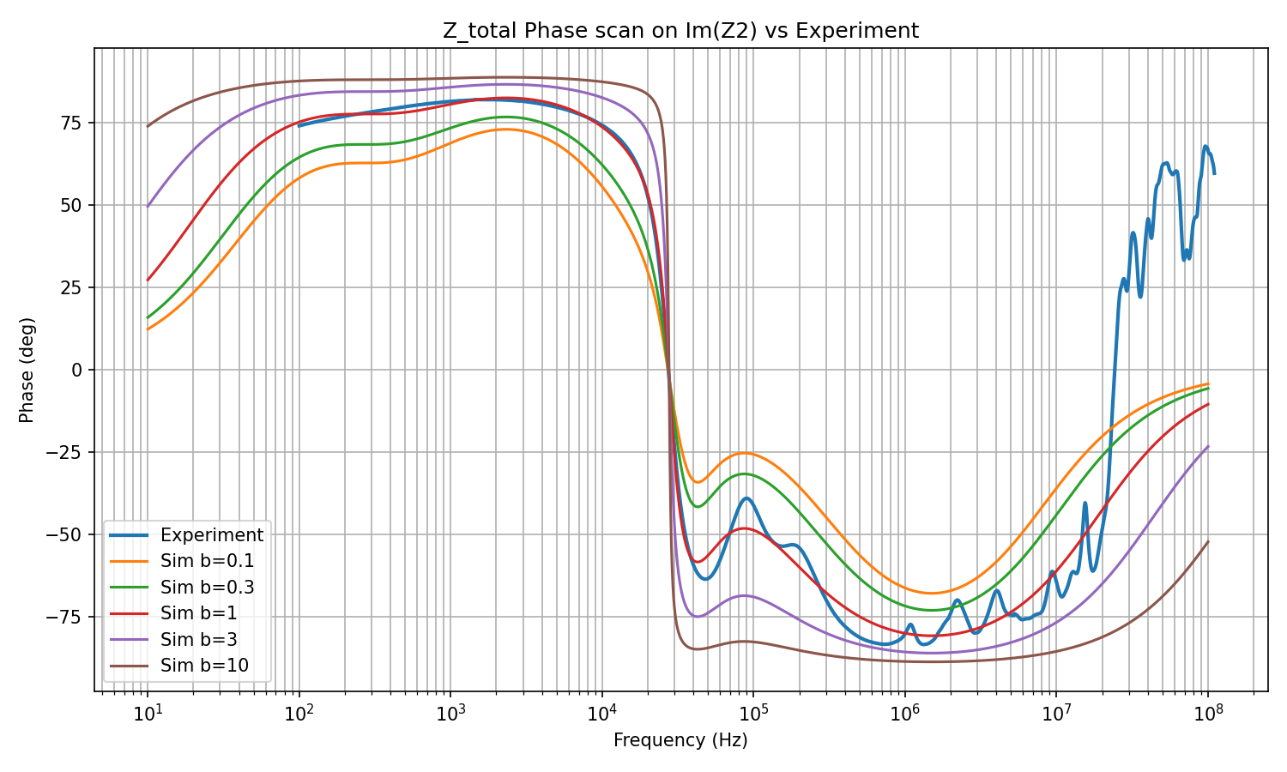
Why Tuning Z2 and Z4 Cannot Fix HF Phase (10–100 MHz)

Slide 9
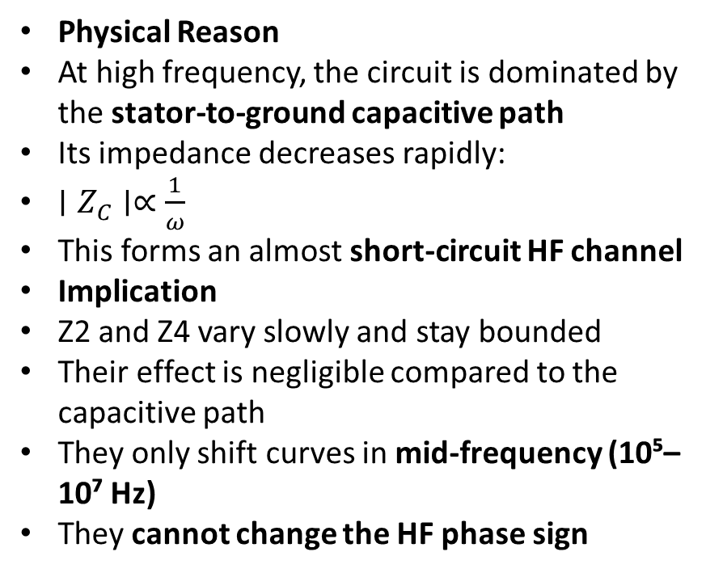
Why Tuning Z2 and Z4 Cannot Fix HF Phase (10–100 MHz)
Observation
Z2 and Z4 were independently scanned (real and imaginary parts, wide range)
Only the phase response was evaluated
Result:
Phase remains capacitive
Or at best approaches 0°
Never becomes inductive, unlike experiments
Conclusion
In the 10–100 MHz range, Z2 and Z4 are no longer dominant
They cannot control the port impedance phase
Physical Reason
At high frequency, the circuit is dominated by the stator-to-ground capacitive path
Its impedance decreases rapidly:
$∣Z_{C}∣∝\frac{1}{ω}$
This forms an almost short-circuit HF channel
Implication
Z2 and Z4 vary slowly and stay bounded
Their effect is negligible compared to the capacitive path
They only shift curves in mid-frequency (10⁵–10⁷ Hz)
They cannot change the HF phase sign

Slide 10
Why Small Parasitic Inductance Is Required at High Frequency
Experimental Evidence
Phase turns from capacitive → inductive
Strong oscillations appear in 10–100 MHz
Typical of parasitic inductance + distributed effects
Order-of-Magnitude Argument
Dominant stator–ground capacitance: nF level
Only tens of nH series inductance is enough to cause phase reversal in 10–100 MHz
Possible Sources
Measurement leads
Ground return loop geometry
Frame-to-ground path
ESL of the capacitance itself
Key Conclusion
Internal lumped branches (Z2, Z4) cannot explain the inductive HF phase
The dominant source is likely the measurement loop + grounding geometry, not the motor internal model
Implication
A small series parasitic inductance must be added to the dominant capacitive path to reproduce the experimental behavior

Slide 11
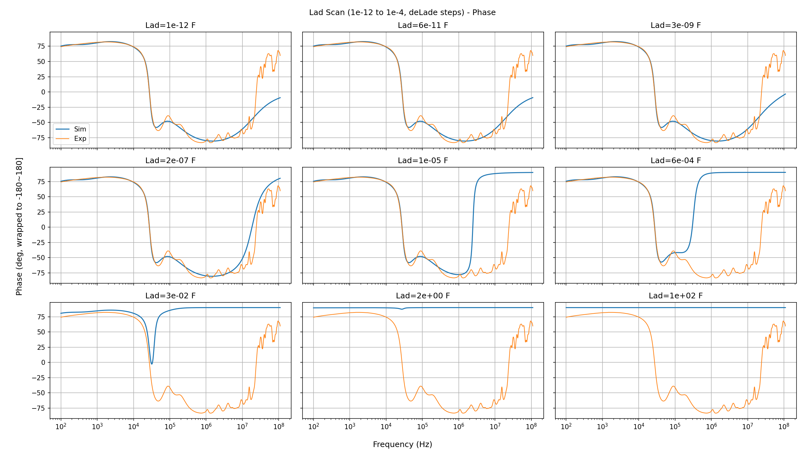
Impedance curve after adding Small Parasitic Inductance

Slide 12
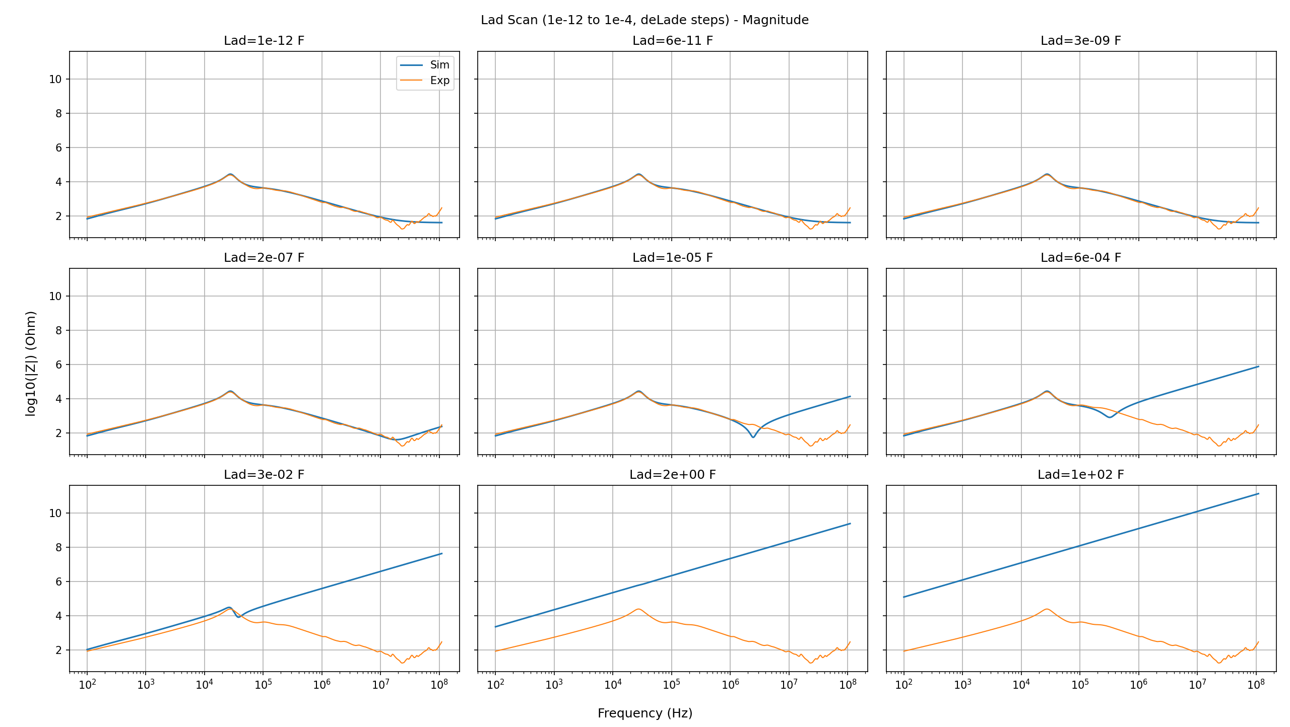
Impedance curve after adding Small Parasitic Inductance

Slide 13
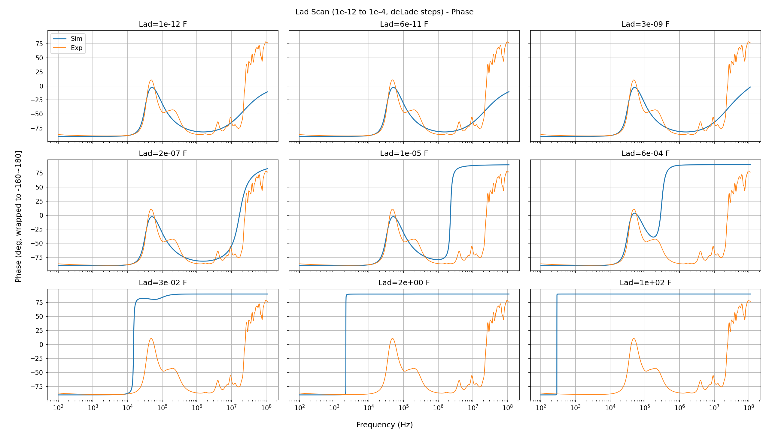
Impedance curve after adding Small Parasitic Inductance

Slide 14
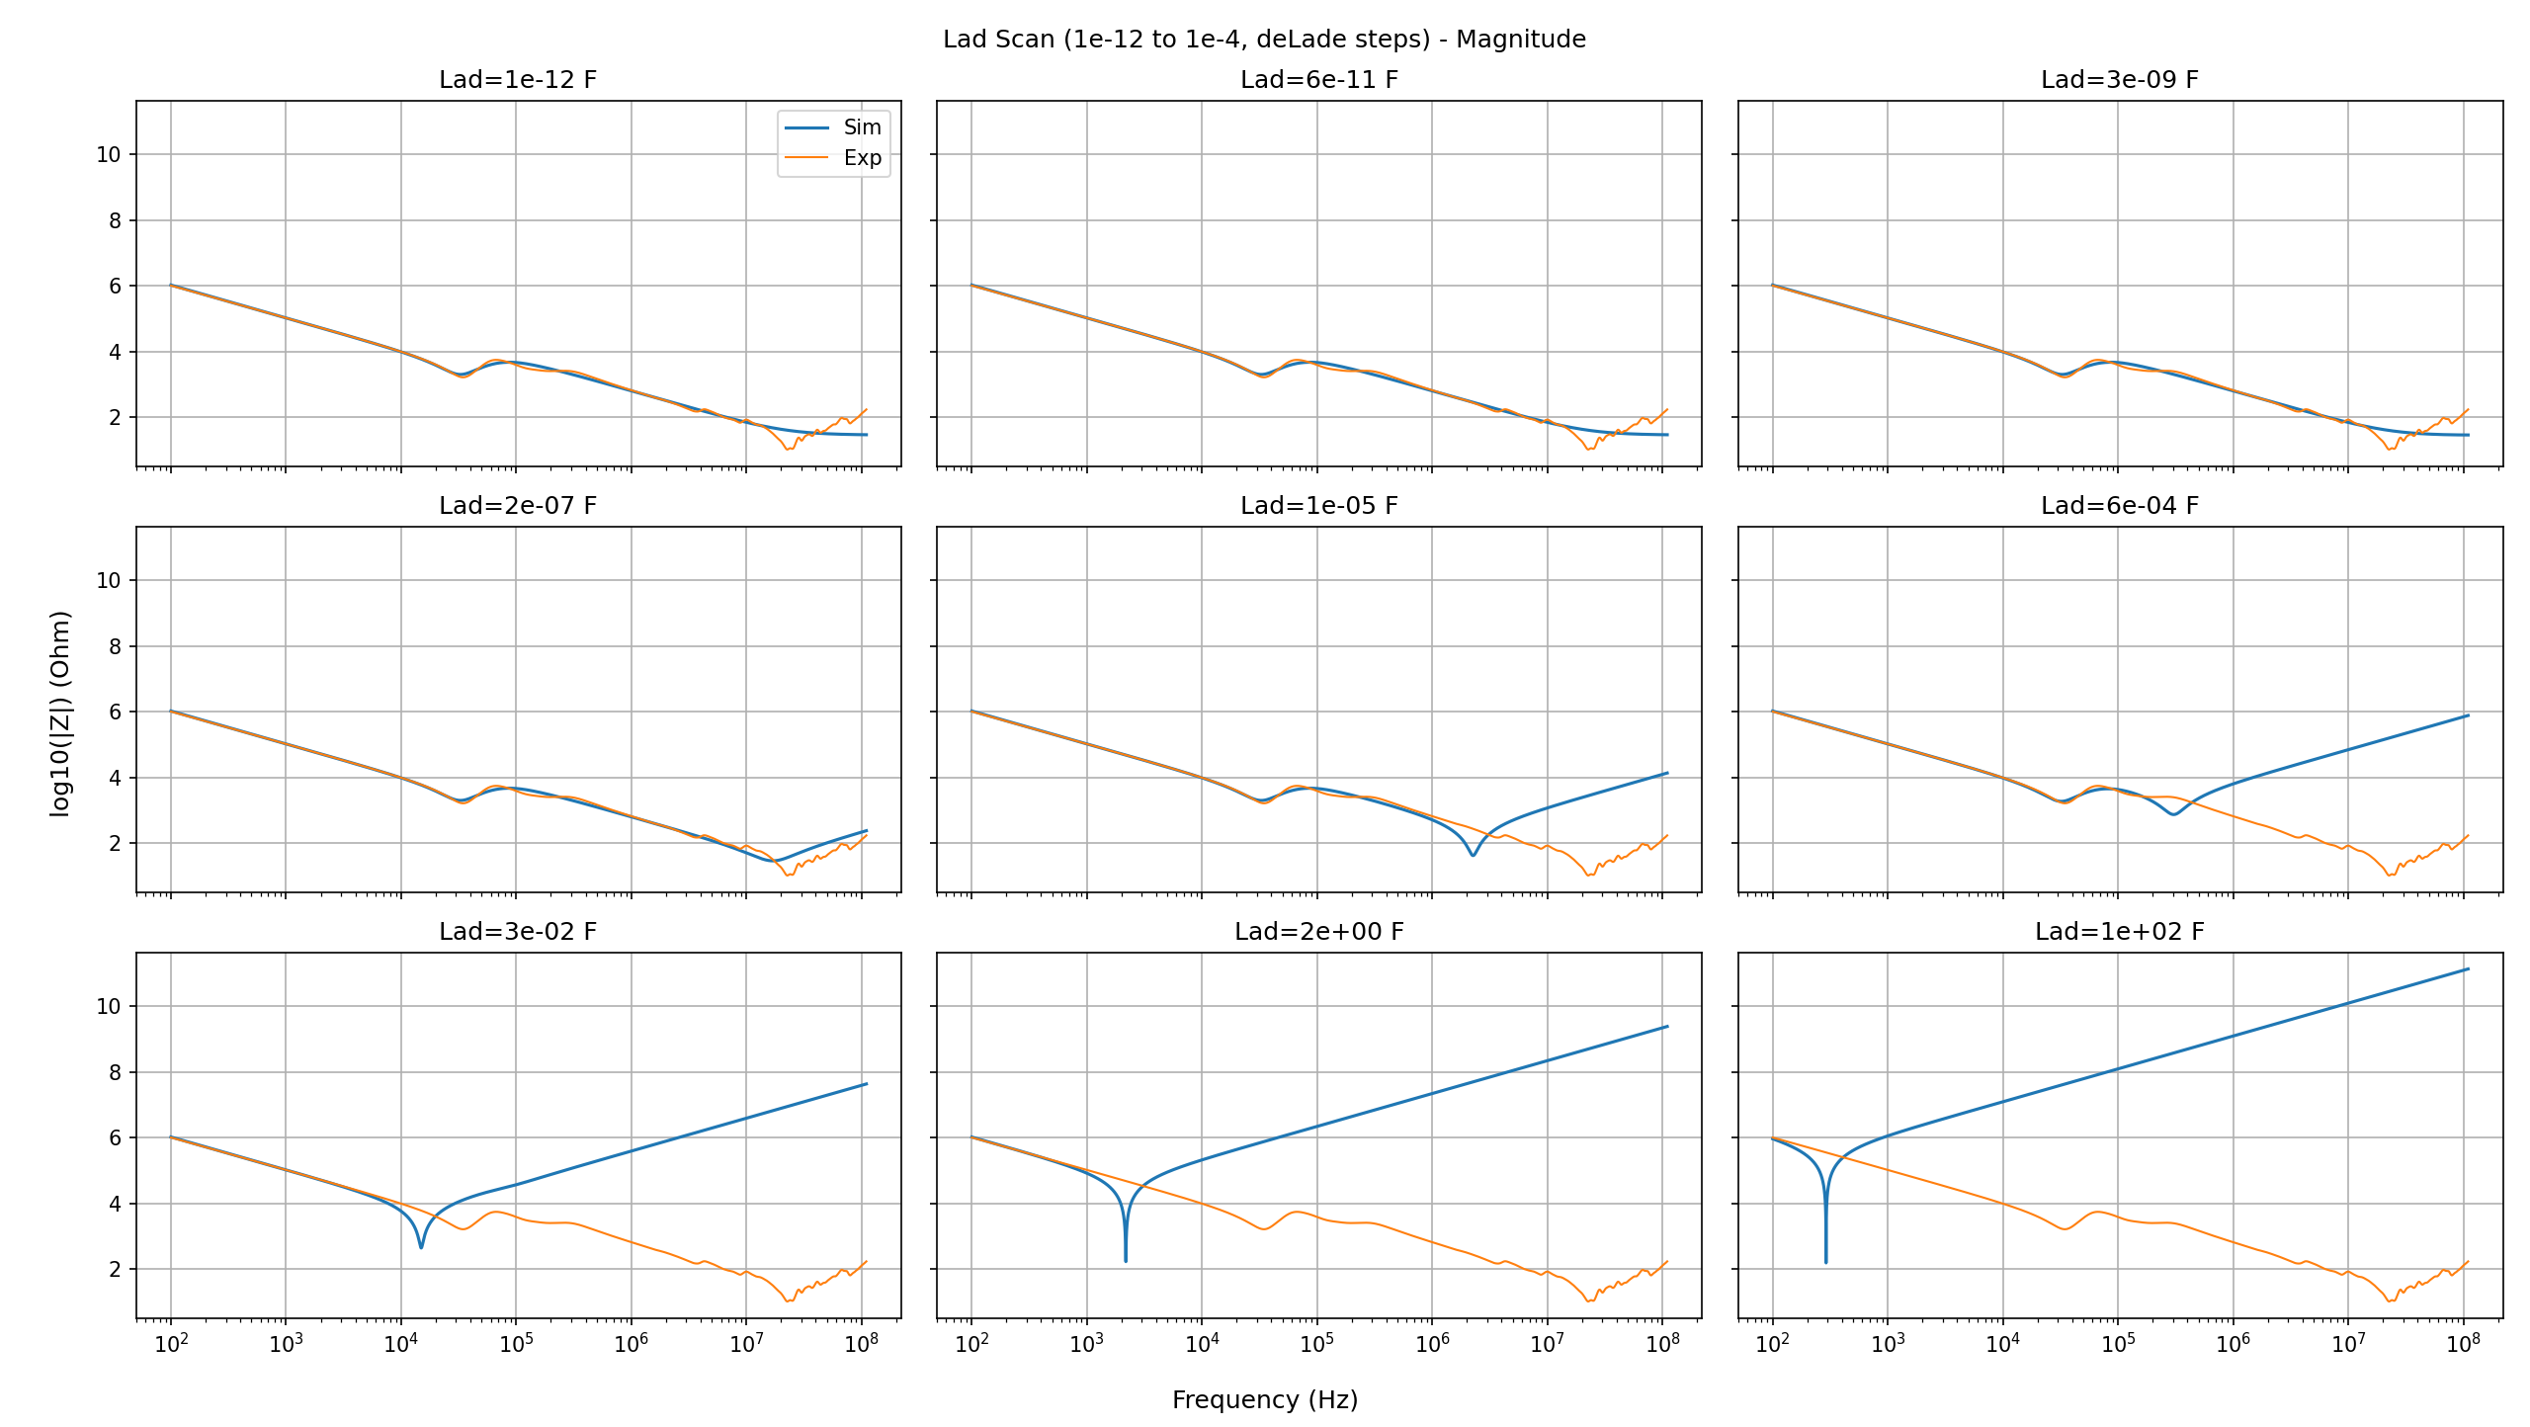
Impedance curve after adding Small Parasitic Inductance

Slide 15
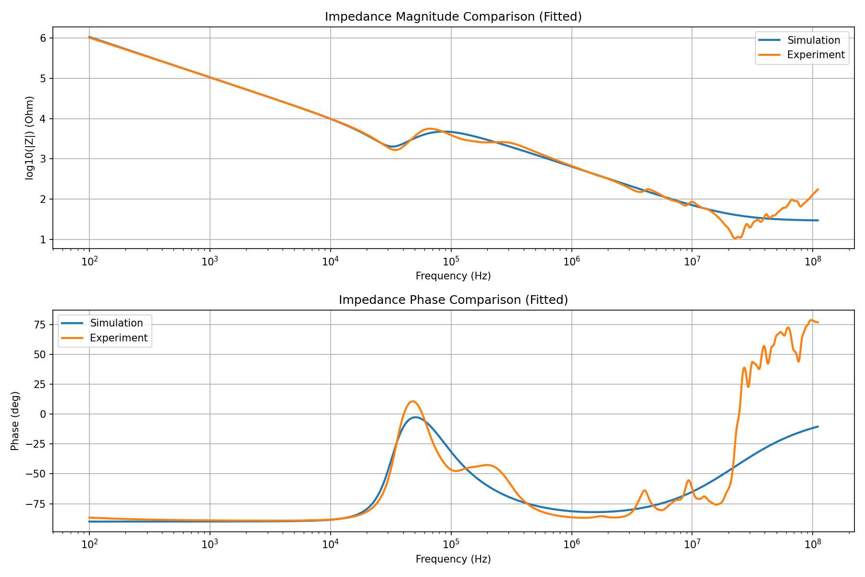
Problems with the universality of parameters

Slide 16
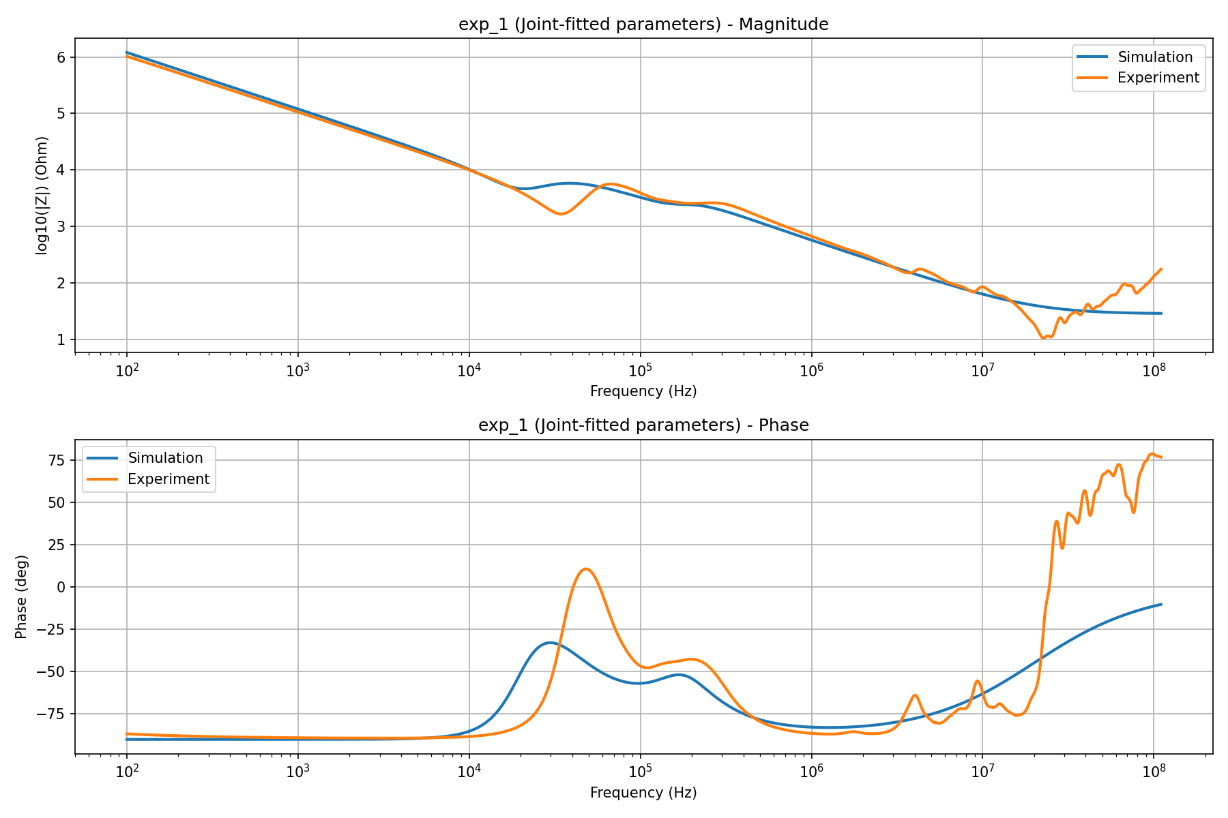
Problems with the universality of parameters

Slide 17
add
第一个: 10兆以内 消融实验 和纯解析 对比
第二个: 100兆 也是和baseline对比 我加了端口 终端 也要仅ai的
第三个: 和纯ai对比 10兆的时候 mlp 和 ga 复现
三种baseline 两个latest
第四个：每个参数动 dm和cm 不要单相 看影响 2(端口2)短 三角形 共8个

